Slide 1
[Name of student]

Slide 2
My Switches
Insert images of the switches that I use here. This may include standard switches such as buddy buttons and talking switches such as a smooth talker or big mack.
My primary switch position
Add a photo of the set up for the switch and location I use most often, i.e. when in
Gear 1: The only switch position (single switch)
Gear 2 & 3: The "easiest" switch position
Gear 4 & 5: The switch that advances the scan (e.g. "next")
My secondary switch position
Add a photo of the set up for the switch and location I use less often.
Gear 2 & 3: The less easy of my switch positions
Gear 4 & 5: The switch that selects the item in the scan (e.g. "this one")
More switch positions
You can add more switch positions beyond two if you like.
Talking switch
Sometimes the talking switch or switches are accessed via an additional switch plugged into the back, rather than accessed directly. Please make this clear if this is the case.
You will also need to modify the "what you'll need" sections on the activity sheets in this example book. Example products are given but these can be modified according to individual need.

Slide 3
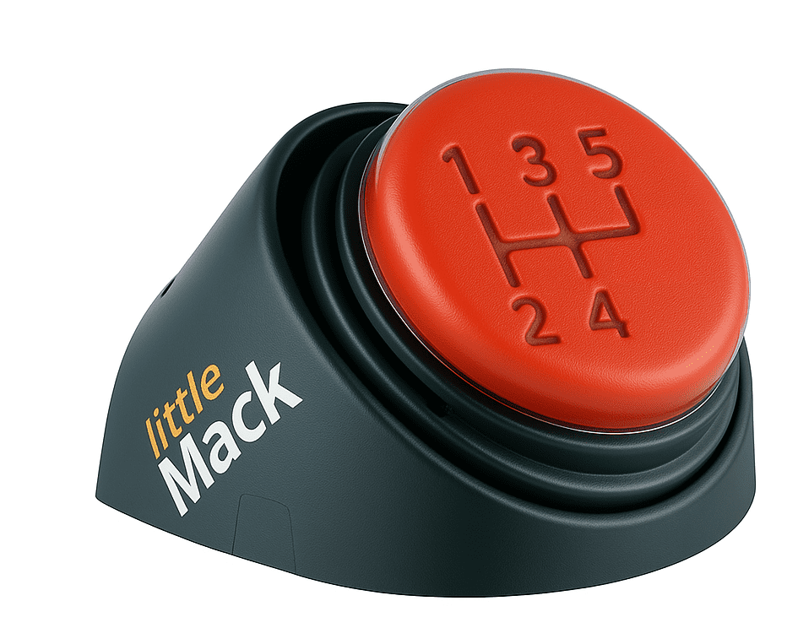
Running on all Gears
Learning to use switches can be thought of like learning to drive a manual car. The early stages get you moving, but after that, the gears can be shifted around based on context and activity.
Our first gear is the important place to begin. Just like you can’t start driving without first gear, you can’t begin switch work without understanding cause and effect. This is the foundational skill that everything else builds on.
Gears 2 to 5 are all about refining and expanding switch use. You don’t always need to use them in order. Sometimes you cruise through all the gears in sequence; sometimes you skip straight to a higher gear, depending on the task and motivation. Other times, you might shift down for more control. Every gear has its place.

Slide 4
Running on all Gears
First Gear
Discover (Cause-and-effect)
Understanding that the switch causes something to happen is an essential first step. Often learners already understand the idea of cause-and-effect in general, but haven’t connected it with switch use.
Use movements the person already makes. Head movements are often a good place to start.
Let them activate the switch accidentally at first. Ensure the response is instantaneous, short and motivating.
Gradually encourage more intentional pressing. Try moving the switch slightly further away.
At this point we’re not looking to teach the pupil a new movement for switch access as we want them to fully concentrate on learning the connection between the switch and the response.
If the learner understands the switch and presses it intentionally - great! You’re ready for second gear.

Slide 5
Running on all Gears
Second Gear
New Movements
Once the person understands that the switch does a load of really cool stuff they are likely to put some effort into learning new movements or using movements which initially they might find difficult. Work around the person’s body to find at least two, if not more, movements that reliably activate the switch. It doesn’t matter too much if these seem clumsy or take a while to initiate - we’ll improve these later. Bring lots of activities and have lots of FUN.
You can use all the first gear activities in second gear simply by changing the position of the switch, plus there are some bonus activities in this book.
Third Gear
Two Switches
Having two switches in two different parts of the body is a bit of a leap that requires coordination, problem solving, sequencing, making choices and a load of other skills. Fortunately, you can learn these skills through FUN activities.
Just remember at this stage the switches do two different things. And when the person chooses a switch be sure that you react quickly!

Slide 6
Running on all Gears
Fourth Gear
Exploring Building and Scanning
At this point the young person is motivated and coordinated to use two or more switches. It’s a good time to introduce the rather peculiar concept of scanning, which involves one switch interacting with the other. Scanning can be taught through error-less activities as it can be a bit confusing at first.
It is also important not to provide someone with a communication aid accessed through switch scanning until they've had a chance to practice and understand scanning. Otherwise, it is likely that they'll use the communication aid to say things that they don't mean to say, as they get to grips with scanning.
Fifth Gear
Scanning with Intent
Scanning provides choice, and we’re able to interpret that choice as an intentional and meaningful way to communicate. Playing computer games that involve scanning to particular cells to ‘win’ is a good start, as is beginning to interact differently to utterances from the communication aid. At this point we assume that if someone scans on the communication aid and says something – they mean it and we act accordingly.

Slide 7
What if they can’t use two switches?
Single Switch Scanning
It is recommended that you work together to find at least two switch sites.
Scanning with a single switch is possible but requires more mental vigilance than two-switch scanning.
A person relying on a single point of movement to control their world can cause complications in the future.
Having access to multiple switches opens up a wider range of activity opportunities.
A two-switch scanner can always revert single switch scanning if they become physically tired.
You can ask the person, their family and other people who know the person to help identify possible movements. Do involve an occupational therapist or physiotherapist to help if needed.
Some people may prefer to use a single switch, or perhaps currently lack the physical skills to use two switches. In these instances, they may wish to develop timing and additional attention skills which are not currently covered in this model. For information on timing activities see the Inclusive Technology / Ian Bean Switch Progression Roadmap.

Slide 8
First Gear
Discovering switches

Slide 9

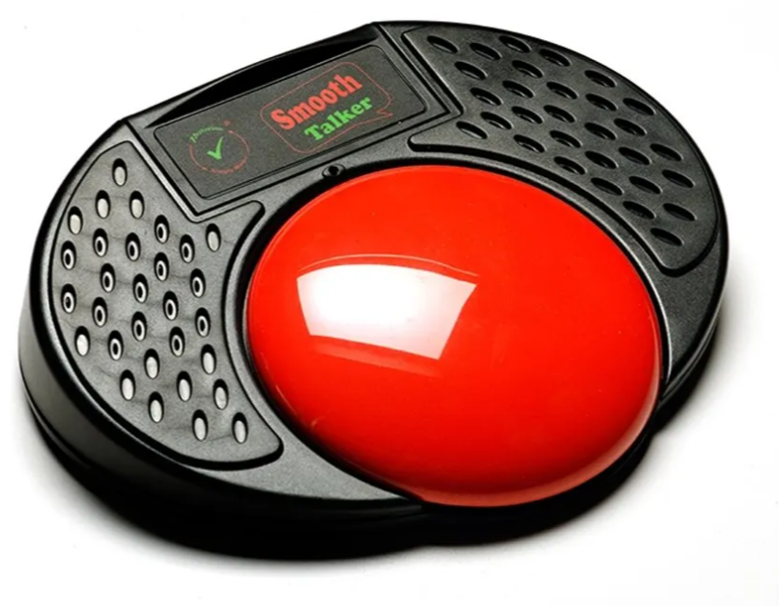
First Gear: Discover (Cause & Effect)
Morning Greetings
I use a talking switch to say good morning to my friends and the staff when I arrive to school every morning.
 | You’ll need to record a “Good Morning” message onto my Smooth Talker audio switch.
 | Plug one of my switches into the smooth talker and position my switch so I can use it.

Slide 10


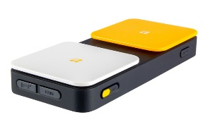
First Gear: Discover (Cause & Effect)
Hold to Play Music
When I hold down my switch music is played. When I let go it stops playing straight away.
 | An iPad with the RadSounds app.
 | A Blue2 Switch Interface
 | Plug one of my switches into the Blue2 and position my switch so I can use it.

Slide 11
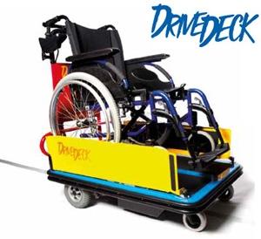
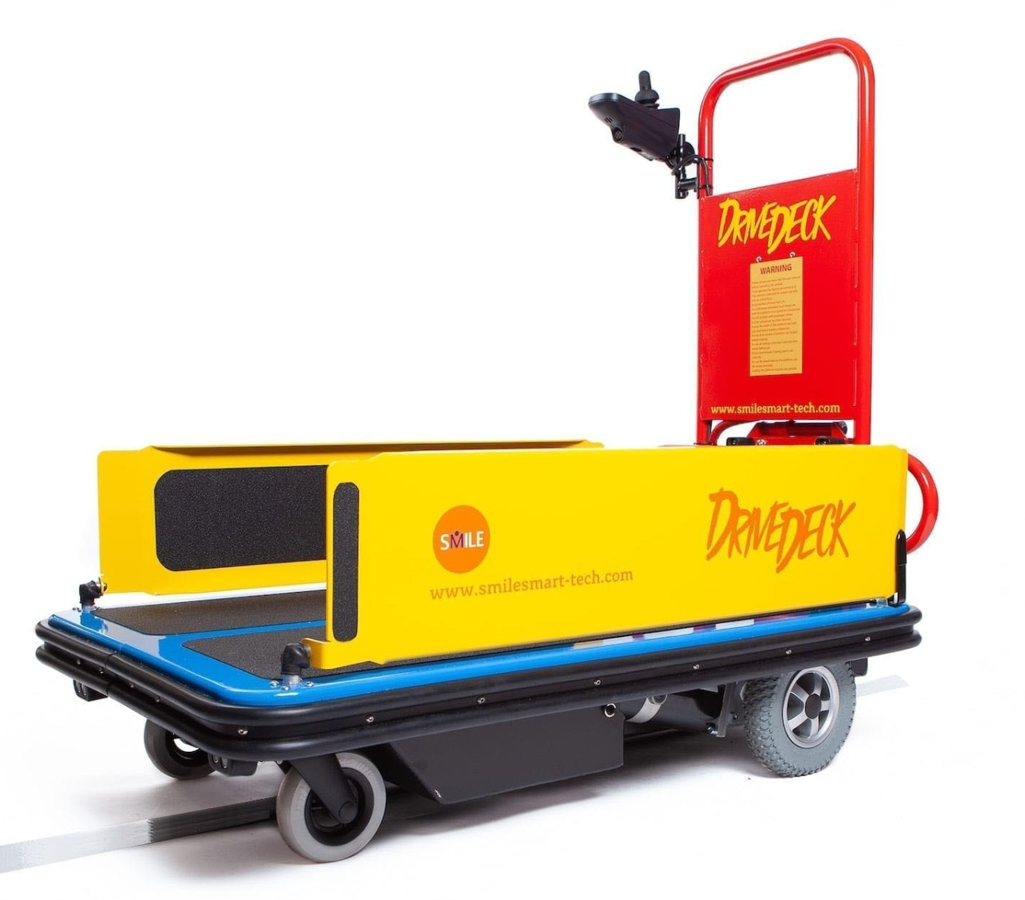
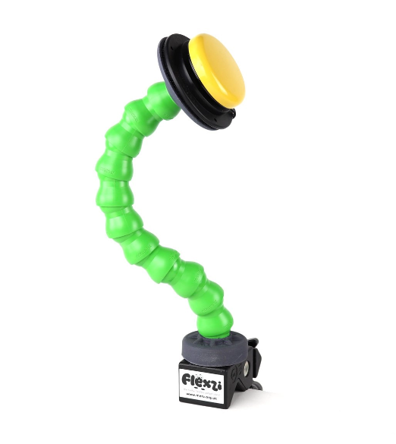
First Gear: Discover (Cause & Effect)
Drive deck
I use a single switch to travel along the track laid around school.
I really like meeting my friends along the way.
 | The drive deck
 | My buddy button on a Meru flexzi mount

Slide 12
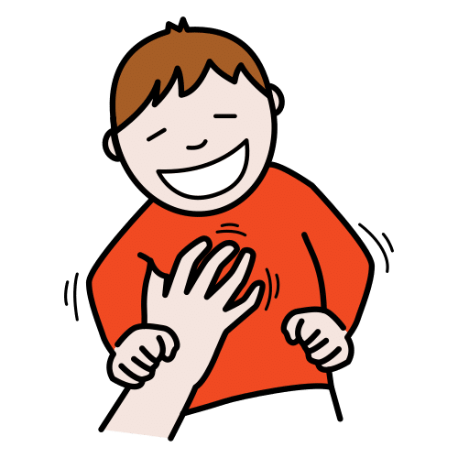

First Gear: Discover (Cause & Effect)
Tickle Time
I love being tickled!
When I press my switch start tickling me straight away very lightly on my sides.
Tickle me for four seconds and then stop! You can tickle me again if I ask for it 😊
 | You’ll need to record a “Tickle Me” message onto a BIGMack talking switch.
 | Plug one of my switches into the BIGMack and position my switch so I can use it.

Slide 13

First Gear: Discover (Cause & Effect)
Who’s Calling!? Prank
I love pranking people!
Whenever I press my call prank switch it makes a phone ringing sound.
Everyone check your phones!
 | You’ll need to record a ringtone onto a smooth talker talking switch.
 | Plug one of my switches into the smooth talker and position my switch so I can use it.

Slide 14


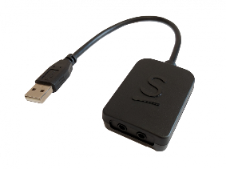
First Gear: Discover (Cause & Effect)
Tin Can Towers
An adult or a classmate uses one switch to build up the tower and I use my switch to smash it down.
This really helps me build my turn-taking and joint attention skills and it’s fun to play this game with someone.
 | My computer
 | Switch Skills for 2 set 2 (app) or HelpKidzLearn (website)
 | My Joycable
 | Plug one of my switches into the JoyCable and position my switch so I can easily use it

Slide 15

First Gear: Discover (Cause & Effect)
Musical Statues
Use a talking switch to say “stop!” someone stops the music and everyone has to freeze. Music is restarted after a 5 second freeze.
You can get the whole class involved ☺
YouTube is useful here - but you can also use iTunes, Spotify or any other music player.
 | You’ll need to record a “Stop” message onto a BIGMack talking switch.
 | Plug one of my switches into the BIGMack and position my switch so I can use it.
 | You might also need a tablet or phone to play music from!

Slide 16
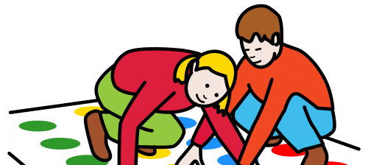
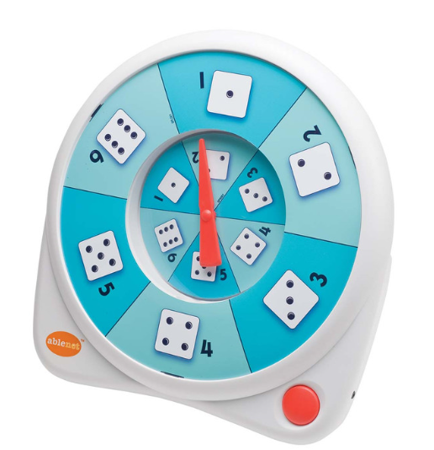
First Gear: Discover (Cause & Effect)
Twister
Instruct people in a game of twister, use your switch to select a body part and a colour.
 | All-Turn-It spinner with colours and body parts labelled.
 | You can plug my switch directly into the spinner.

Slide 17
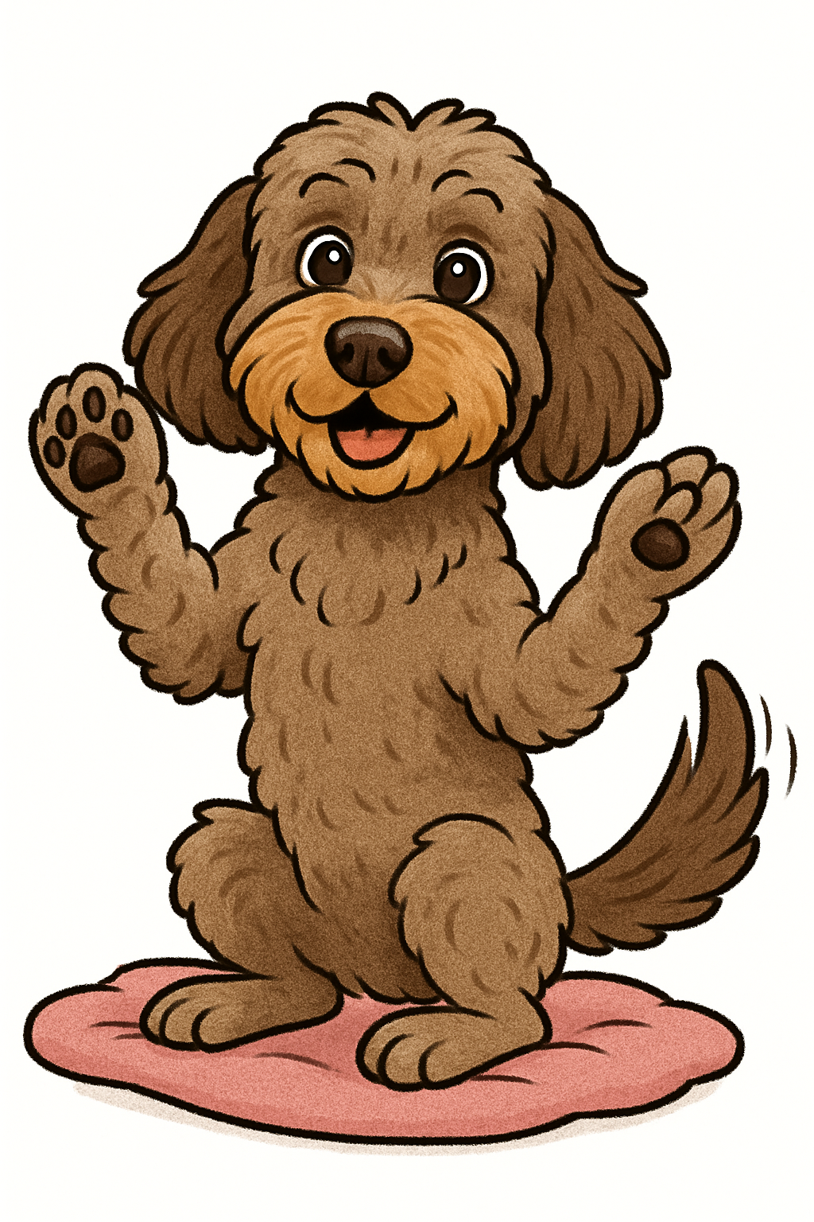
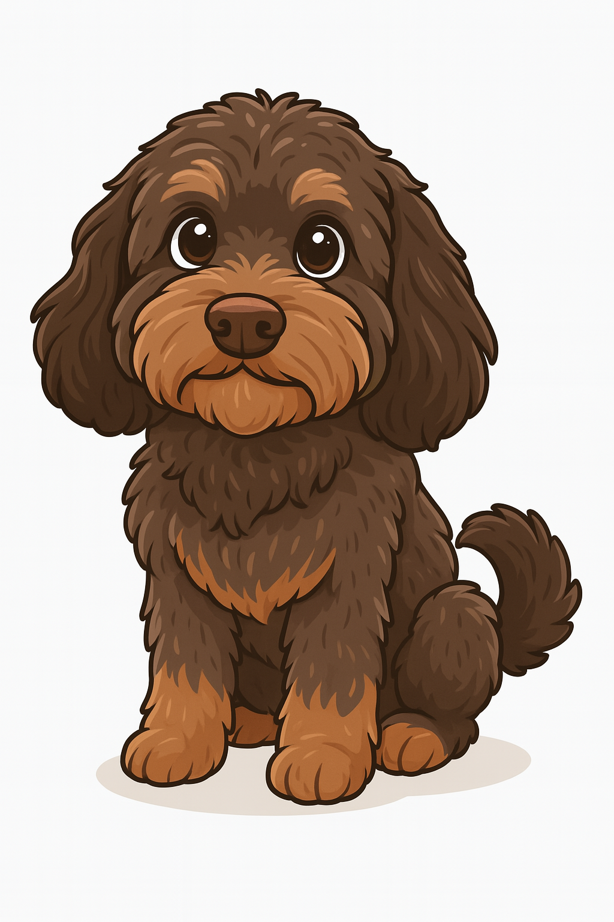
First Gear: Discover (Cause & Effect)
Doggy Tricks
I love to watch Ada do her tricks.
Record a single trick onto my talking switch, and keep the treats handy to reward her.
 | Ada, my dog
 | Doggy treats
 | You’ll need to record her commands such as “paw” onto my BIGMack talking switch.
 | Plug one of my switches into the BIGMack and position my switch so I can use it.

Slide 18

First Gear: Discover (Cause & Effect)
Farts Prank
Set up my switch to prank people with a fart noise.
Make them laugh, make them say ewww or blame it on someone else!
 | You’ll need to record a fart noise onto a smooth talker talking switch.
 | Plug one of my switches into the smooth talker and position my switch so I can use it.

Slide 19
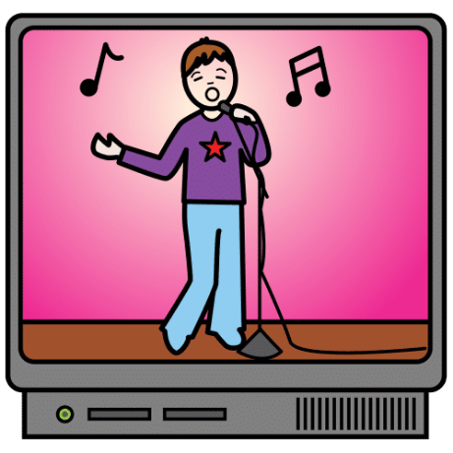
First Gear: Discover (Cause & Effect)
Music Start & Stop
Use a talking switch to say “more” so that I need to press my switch to keep the music going. Try stopping every four seconds and then give me a whole song at the end as a reward. YouTube is useful but you can also use iTunes, Spotify or any other music player.
 | You’ll need to record a “More” message onto my BIGMack talking switch.
 | Plug one of my switches into the BIGMack and position my switch so I can use it.

Slide 20
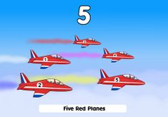
First Gear: Discover (Cause & Effect)
Five Red Planes
This is my favourite game on HelpKidzLearn although I might get bored if I play it too much!
When I press my switch a new plane is added and a song is played. I need reminding to watch out for the cues so I know when to press my switch.
 | My computer
 | HelpKidzLearn website (you might need the username and password) on a PC.
 | My JoyCable switch interface
 | Plug one of my switches into the JoyCable and position it so I can use it.

Slide 21
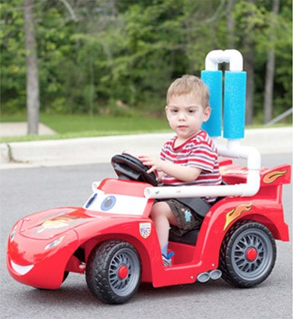
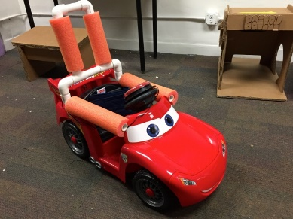
First Gear: Discover (Cause & Effect)
Go Baby Go!
I love to drive my car! I do this outside so just make sure I’m comfy and safe in the seat and that I can reach my hand switch. Off I go!
 | My adapted car! There’s already a big switch mounted to the steering wheel.
 | Lots of indoor space for me to explore.

Slide 22
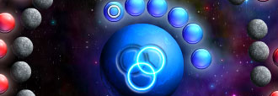
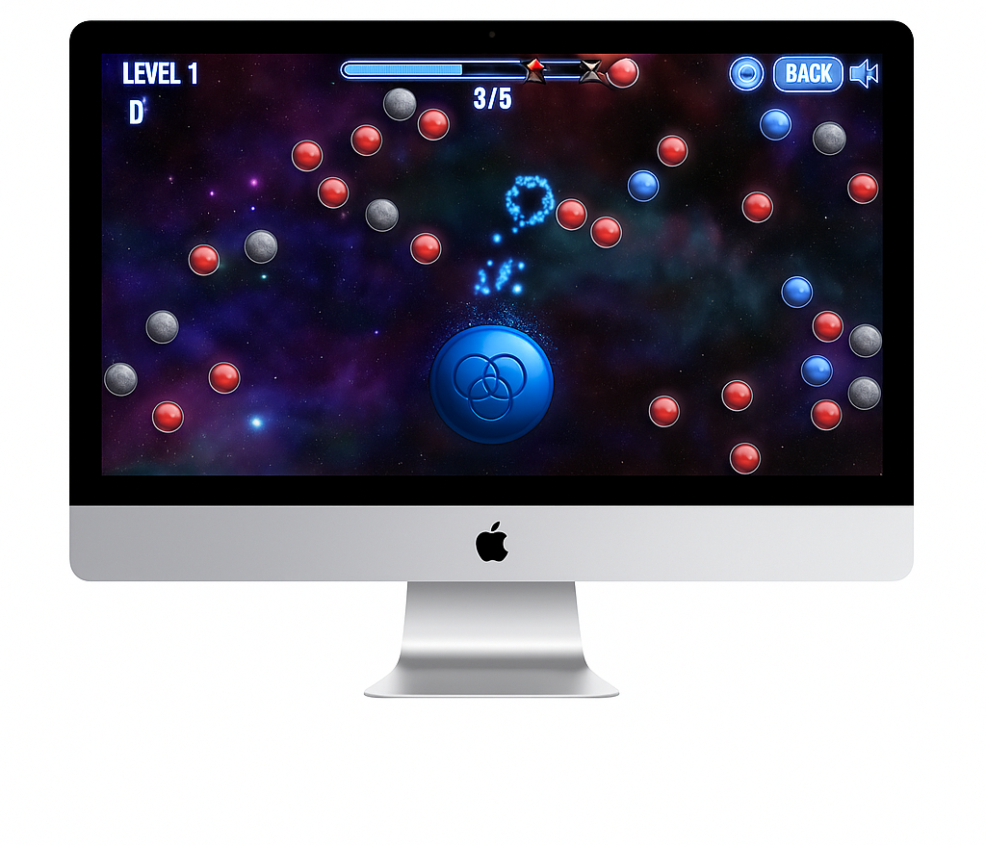
First Gear: Discover (Cause & Effect)
Catchy Orbit
This is a really cool computer game, just like my brothers play.
 | My computer
 | The catchy Orbit App is on the desktop.
 | A JoyCable Switch Interface
 | Plug one of my switches into the JoyCable and position my switch so I can use it.

Slide 23
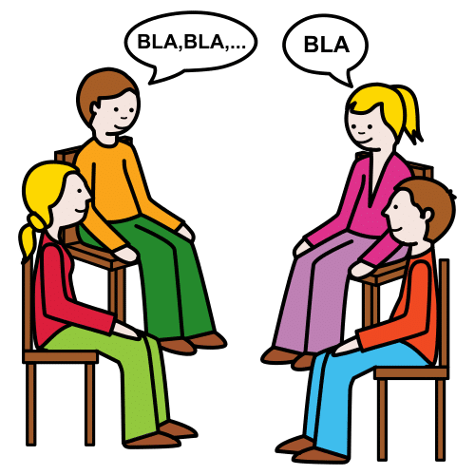
First Gear: Discover (Cause & Effect)
Sharing News
I like to share news about what I’ve been doing, such as telling my friends what I got up to on the weekend.
 | You’ll need to record the news onto a smooth talker talking switch.
 | Plug one of my switches into the smooth talker and position my switch so I can use it.

Slide 24

First Gear: Discover (Cause & Effect)
Show & Tell
Let me participate in show and tell, choose an item that I enjoy or has a cool story behind and tell my friends all about it.
 | Record a message onto a BIGMack talking switch that tells us all about their show and tell item.
 | Plug one of my switches into the BIGMack and position my switch so I can use it.

Slide 25
First Gear: Discover (Cause & Effect)
Who’s Calling!? Prank
I love pranking people!
Whenever I press my call prank switch it makes a phone ringing sound.
Everyone check your phones!
 | You’ll need to record a ringtone onto a smooth talker talking switch.
 | Plug one of my switches into the smooth talker and position my switch so I can use it.

Slide 26

First Gear: Discover (Cause & Effect)
School Errands
I love helping people!
Send me on an errand such as asking for a book from another classroom or returning the register to reception.
 | You’ll need to record the errand/question/request onto a BIGMack talking switch.
 | Plug one of my switches into the BIGMack and position my switch so I can use it.

Slide 27

First Gear: Discover (Cause & Effect)
Initiate Conversation
I need to gain attention to indicate to others that I have something to say.
Grab my paper-based communication aid when I ask for it.
 | Record a message onto a smooth talker talking switch such as “I have something to say, please get my communication book”.
 | Plug one of my switches into the smooth talker and position my switch so I can use it.

Slide 28
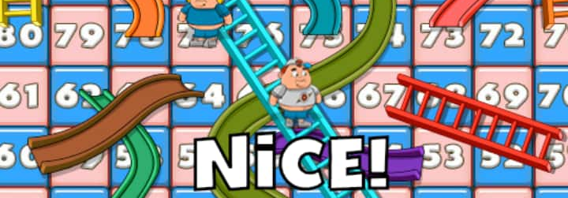
First Gear: Discover (Cause & Effect)
Snakes & Ladders
I can use a single switch to throw an electronic dice. Consider putting the game up on a classroom smartboard so I can play with the rest of the class!
 | All-Turn-It spinner with the dice inserts. You can plug my switch directly into the spinner.

Slide 29
Second Gear
New Movements

Slide 30
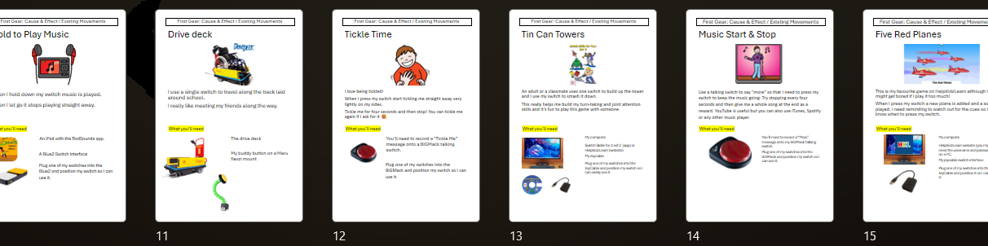
Second Gear: New Movements
All First Gear Activities
All the activities I’ve been doing in first gear I can also do in second gear.
Simply change the position of the switch to encourage new movements.
 | Any resources required by that activity (check through the First Gear list).
 | You may need different mounts to hold the switch in different places, such as my Flexi arm.

Slide 31

Second Gear: New Movements
Body Bop Start & Stop
I say “more” to keep the music going.
Stop the music every four seconds and moved the switch to another body part on me.
I need to move my body to keep you moving!
If I work hard I can hear the whole song at the end ☺
 | You’ll need to record a “Stop” message onto a BIGMack talking switch.
 | Plug one of my switches into the BIGMack and position my switch so I can use it.
 | You might also need a tablet or phone to play music from!

Slide 32

Second Gear: New Movements
Book: The Very Hungry Caterpillar
Set up my talking switch to say “turn the page.” You can swap between my hand switch and my head switch to help me practice both switch positions.
 | You’ll need the book “The very hungry caterpillar” by Eric Carle
 | You’ll also need one talking switch for this activity to work. Record “Turn the page” message onto the BIGMack talking switch.
 | I’ll need both my hand switch and my head switch set up at the same time for this to work.

Slide 33
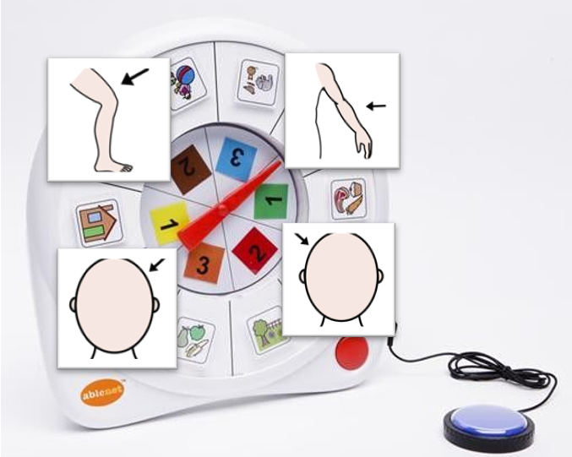
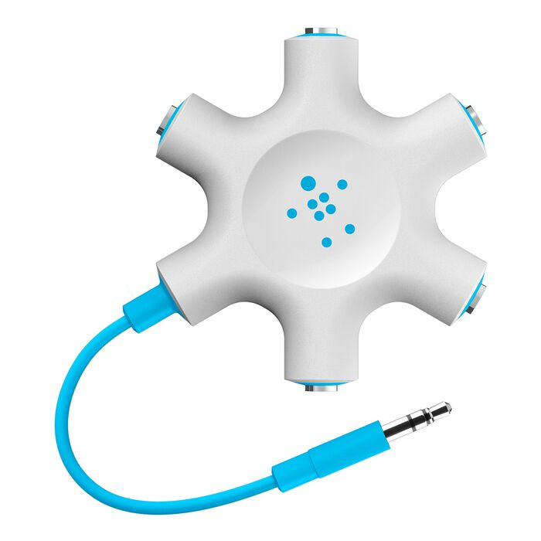
Second Gear: New Movements
Spin to Position
This is a fun game where I spin the wheel to find out which movement I’m doing next to hit the switch.
Some movements are easy and some are difficulty – but I like the challenge!
 | AbleNet Spinner with four body part labels.
 | Four flexi mounts with a switch mounted on each one.
 | My Rockstar Switch Splitter
 | Plug the rockstar into the spinner, and plug my switches into the rockstar.
x4

Slide 34

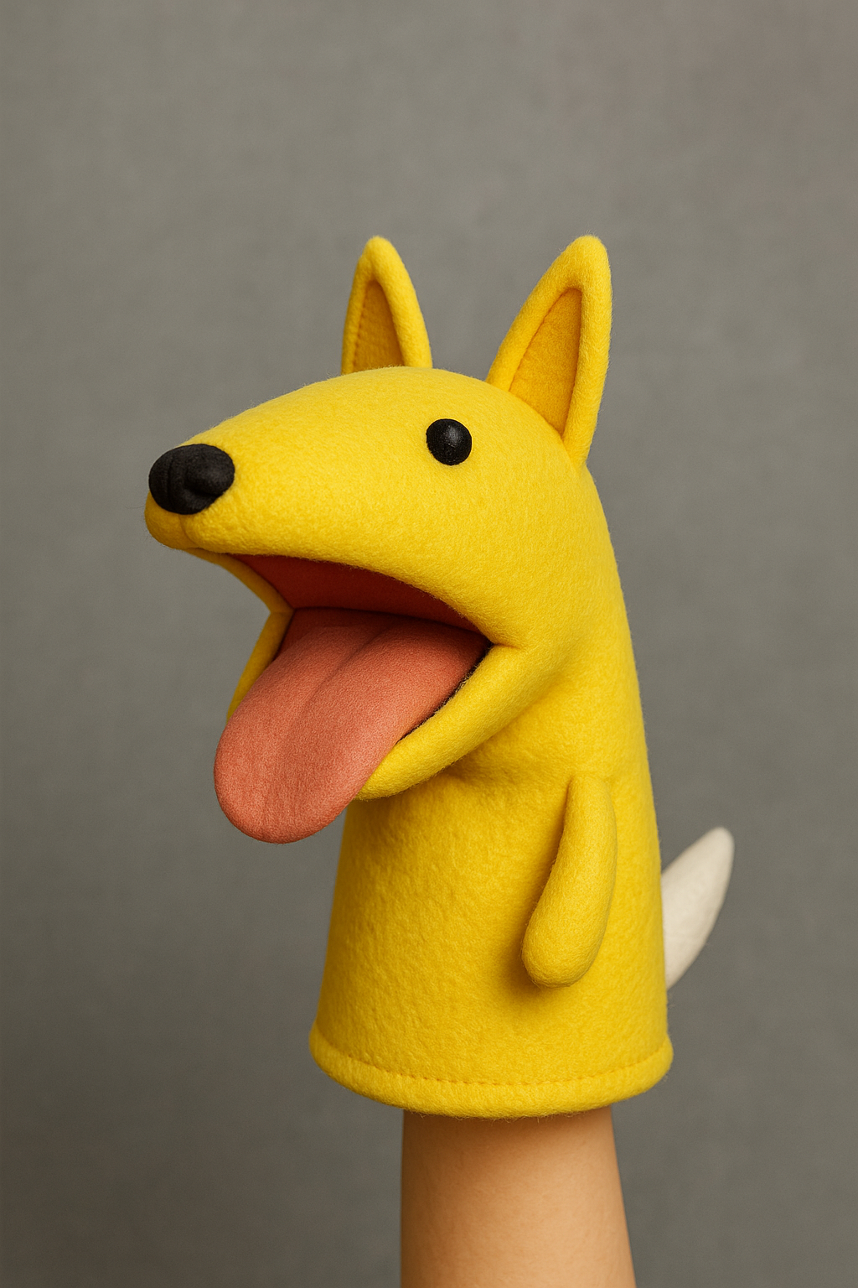
Second Gear: New Movements
Vomiting Vincent
Vincent loves eating switches, but has a habit of feeling a bit queasy afterwards.
When I press my switch I tempt Vincent to eat another switch, which he always does. But he can’t help vomiting it back up somewhere nearby!
 | Vincent Puppet
 | Four flexi mounts with a switch mounted on each one.
 | My BIGMack switch
 | My Rockstar Switch Splitter
 | Plug the rockstar into the BIGMack socket marked “switch”.
 | Plug the four switches into the rockstar.
x4

Slide 35
Third Gear
Two switches

Slide 36
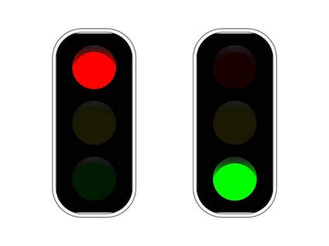
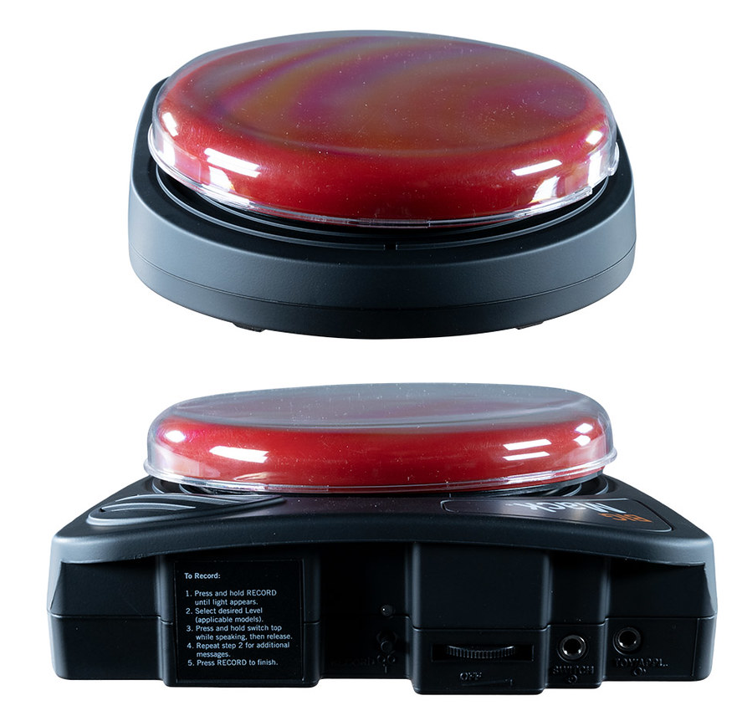
Third Gear: Two Switches
Red Light Green Light
People run towards me. When I say “red light!” they must stop and not move until I say “green light”.
If anyone moves when they’re not suppose to, then they’re out of the game!
 | I’ll need both my BigMacks. Record a clear “Green light!” message onto one BIGMack. Record “Red light!” onto the second BIGMack.
 | Plug my head and hand switches into the back of the BIGMacks into the socket labelled “switches”

Slide 37

Third Gear: Two Switches
Right or Wrong
Ask me a range of questions/statements that I can guess are either right or wrong, be as silly as you want!
An example could be “Spiders sing opera”
 | I’ll need both my smooth talker switches. Record a clear “RIGHT!” message onto one smooth talker. Record “WRONG!” onto the second smooth talker.
 | Plug my head and hand switches into the back of the smooth talkers into the socket labelled “switches”

Slide 38
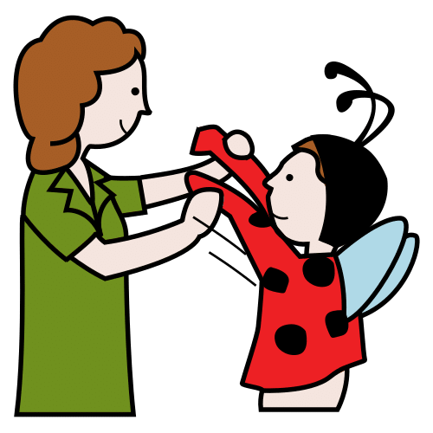
Third Gear: Two Switches
Dress Up for 2
Have a selection of dress up items that you hold up one by one.
I can choose who gets to wear what by saying my name, or your name with my switch.
 | I’ll need both my BigMacks. Record nm name onto one BIGMack. Record your name onto the second BIGMack.
 | Plug my head and hand switches into the back of the BIGMacks into the socket labelled “switches”

Slide 39

Third Gear: Two Switches
Who’s most likely to…?
Someone asks me a silly question such as “who's most likely to fall over?” or “who’s most likely to fall asleep on the couch?”.
I then choose between the names on your switches, this could be two friends, your mum and dad, siblings etc.
 | I’ll need both my smooth talker switches. You’ll need to record a name on each talking switch. Such as one switch says “Mum” one switch says “Dad”
 | Plug my head and hand switches into the back of the smooth talkers into the socket labelled “switches”

Slide 40

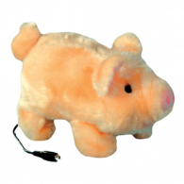
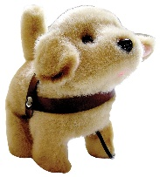
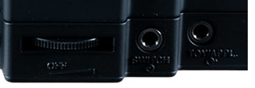
Third Gear: Two Switches
Pig Dog Derby
I use both my switches to race Miss Piggy and Jeff the Dog.
Don’t forget to make the racecourse interesting add some puddles, potholes, table edges, distracting food and other surprises!
I love to hear people commentating on the race ☺
 | Miss Piggy and Jeff the Dog
 | Both my BIGMacks. Record “Go Ms Piggy!” message onto one BIGMack. Record “Go Jeff” onto the second BIGMack.
 | I’ll need both my hand switch and my head switch set up at the same time for this to work.
 | Plug my head and hand switches into the back of the BIGMacks into the socket labelled “switches” Plug the Ms Piggy and Jeff into the sockets marked “Toy/Appliance”

Slide 41
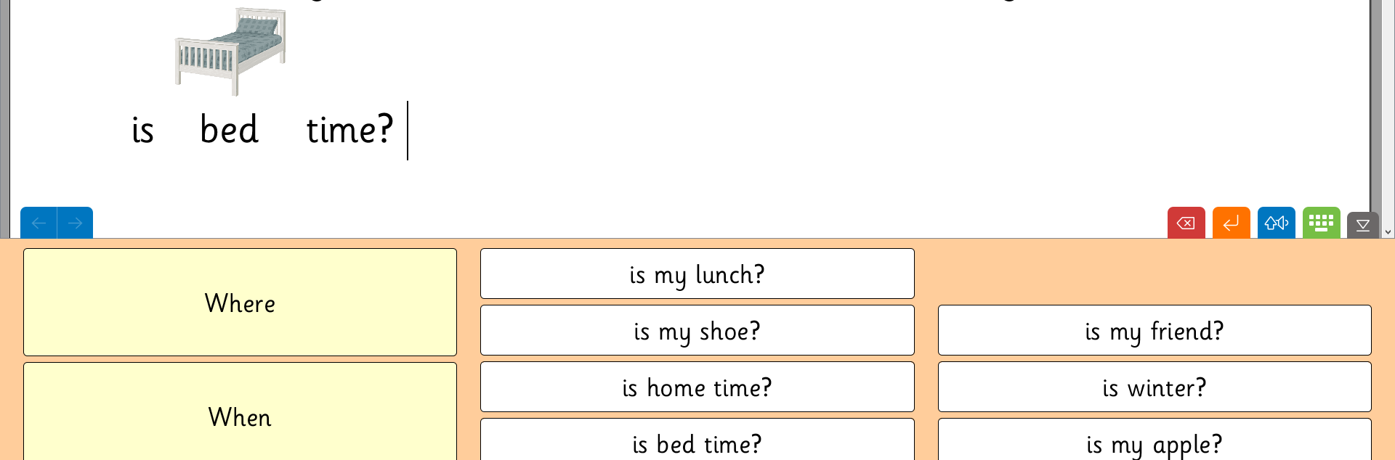

Third Gear: Two Switches
Cloze Procedures in Clicker
Clicker is usually accessed via scanning, which requires fourth gear.
Here we’re building sentences with two buttons, choosing from two words.
I’m choosing the word, you’re helping with Clicker.
 | My computer running Clicker (you’ll find the icon on the desktop)
 | My cloze procedure Clicker grids (in my folder)
 | My BIGMacks.
 | Record “Where” message onto one BIGMack talking switch. Record “When” onto the second BIGMack.
 | You’ll need to record different words for different clicker grids!
 | I’ll need both my hand switch and my head switch set up at the same time for this to work.

Slide 42


Third Gear: Two Switches
Tin Can Towers 2
I’m using one switch to build the tower and the other switch to smash it down!
 | My computer running Switch Skills 2 app or HelpKidzLearn (web).
 | My switch interface (JoyCable)
 | I’ll need both my hand switch and my head switch set up at the same time for this to work. Plug them into the JoyCable.

Slide 43
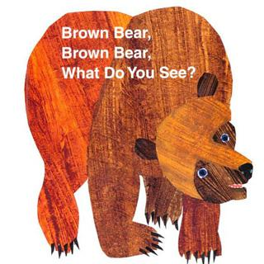

Third Gear: Two Switches
Book: Brown Bear
This is one of my favourite books and I can join in by saying “What” and “See.” You can make this more interesting by nominating a class friend to pull items out of a box.
 | You’ll need the book “Brown Bear Brown bear what do you see?” by Bill Martin Jr
 | You’ll also need two talking switches for this activity to work. Record “What” message onto one smooth talker switch. Record “See” onto the second smooth talker.
 | I’ll need both my hand switch and my head switch set up at the same time for this to work.

Slide 44


Third Gear: Two Switches
Book: The Train Ride
You can get the whole class involved by creating a train with chairs placed one in front of another. You could also bring up train destinations on the whiteboard.
 | You’ll need the Book “The train Ride” by June Crebbin.
 | You’ll also need two talking switches for this to work. Record “What” message onto one BIGMack talking switch. Record “See” onto the second BIGMack. You could also choose to use “Go” and “Stop.”
 | I’ll need both my hand switch and my head switch set up at the same time for this to work.

Slide 45

Third Gear: Two Switches
Book: Walking Through the Jungle
You can get the whole class involved by moving around the classroom, using the whiteboard to bring up scenes.
 | You’ll need the book “Walking through the Jungle” by Julie Lacome
 | You’ll also need two talking switches for this activity to work. Record “What” message onto one smooth talker switch. Record “See” onto the second smooth talker. You could also choose to use “Go” and “Stop.”
 | I’ll need both my hand switch and my head switch set up at the same time for this to work.

Slide 46

Third Gear: Two Switches
Book: We’re Going on a Bear Hunt
You can get the whole class involved by filling the class with obstacles and moving around the classroom, bring up scenes on the whiteboard.
 | You’ll need the book “We’re going on a bear hunt” by Michael Rosen
 | You’ll also need two talking switches for this to work. Record “Over” message onto one BIGMack talking switch. Record “Under” onto the second BIGMack. Can be used to instruct the class to go over and under obstacles.
 | I’ll need both my hand switch and my head switch set up at the same time for this to work.

Slide 47
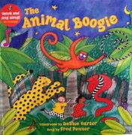
Third Gear: Two Switches
Book: The Animal Boogie
I can say “here” and “there” throughout the book using my switches.
 | You’ll need the book “The Animal boogie” by Debbie Harter.
 | You’ll also need two talking switches for this to work. Record “Here” message onto one smooth talker switch. Record “There” onto the second smooth talker.
 | I’ll need both my hand switch and my head switch set up at the same time for this to work.

Slide 48

Third Gear: Two Switches
Book: Yuck!
I can use my switches to tell you whether things are “yuck” or “yum!”
 | You’ll need the book “Yuck!” by Mick Manning & Brita Granstrom.
 | You’ll also need two talking switches for this activity to work. Record “Yum!” message onto one BIGMack talking switch. Record “Yuck!” onto the second BIGMack. You can also play a game with a range of food and other items you may or may not like to eat – yum and yuck.
 | I’ll need both my hand switch and my head switch set up at the same time for this to work.

Slide 49

Third Gear: Two Switches
Book: What do you like?
We can read this book together or involve the class by doing a survey asking what they like and don’t like.
 | You’ll need the book “What do you like?” by Michael Grejniec.
 | You’ll also need two talking switches for this activity to work. Record “I like!” message onto one smooth talker switch. Record “Not!” onto the second smooth talker.
 | I’ll need both my hand switch and my head switch set up at the same time for this to work.

Slide 50

Third Gear: Two Switches
Book: Hello, Goodbye
We can read this book together or involve everyone by saying hello and goodbye to people as I travel around the school.
 | You’ll need the book “Hello, Goodbye” by David Lloyd
 | You’ll also need two talking switches for this activity to work. Record “Hello” message onto one BIGMack talking switch. Record “Goodbye” onto the second BIGMack.
 | I’ll need both my hand switch and my head switch set up at the same time for this to work.

Slide 51
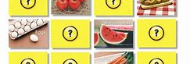
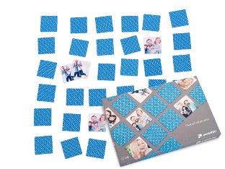
Third Gear: Two Switches
Matching Game
This is the classic memory matching game, play with other students who can choose cards.
 | Picture cards or photo pairs (e.g. from Puzzle You)
 | You’ll also need two talking switches for this activity to work. Record “Same” message onto one smooth talker switch. Record “Different” onto the second smooth talker.
 | I’ll need both my hand switch and my head switch set up at the same time for this to work.

Slide 52
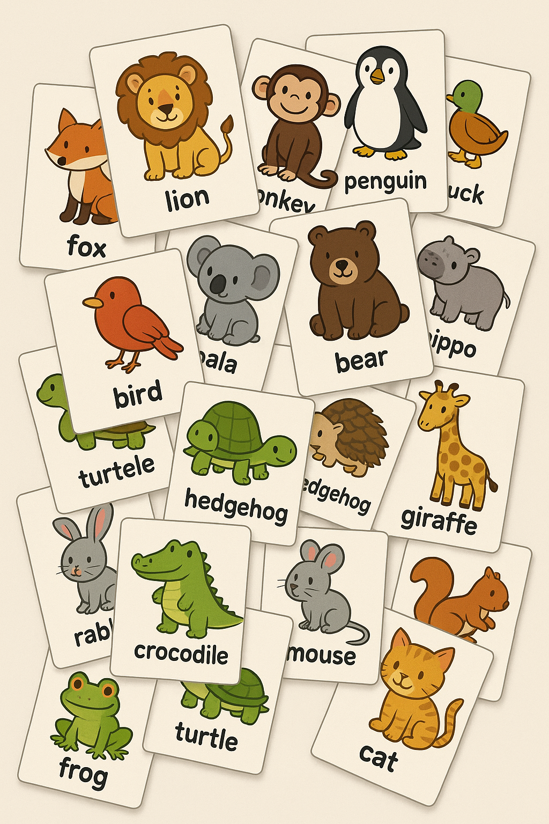
Third Gear: Two Switches
Bigger or Smaller?
Images of animals are printed on cards, and I must guess whether the next animal in the deck is bigger or smaller than the previous.
 | Animal cards
 | You’ll also need two talking switches for this activity to work. Record “Same” message onto one BIGMack talking switch. Record “Different” onto the second BIGMack.
 | I’ll need both my hand switch and my head switch set up at the same time for this to work.

Slide 53
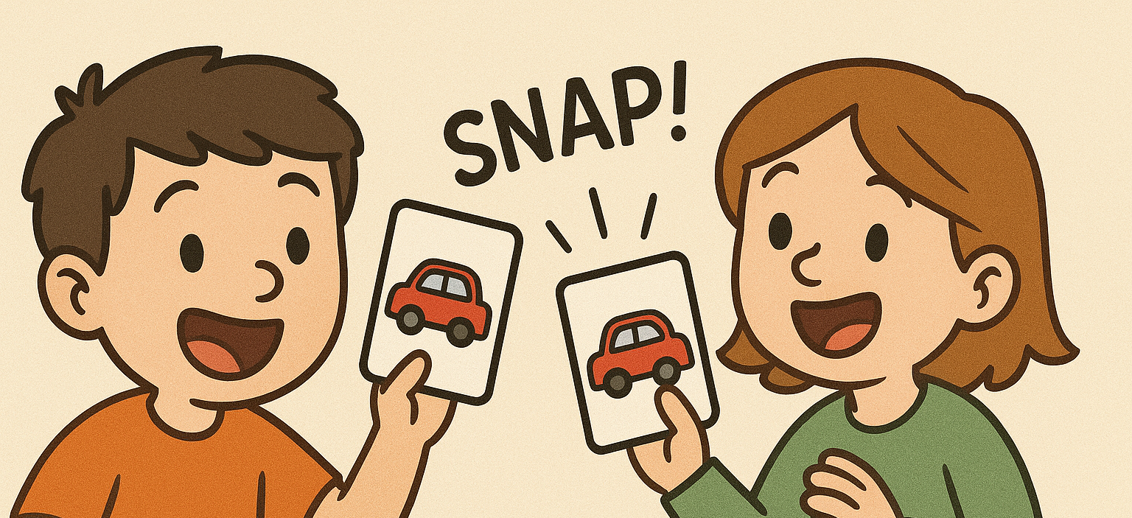

Third Gear: Two Switches
Snap!
Scan through my vehicle snap set one by one, turning a page every time I say “next.”
If two cards come out the same I can win a point by saying “snap!”
 | My snap game (vehicles)
 | You’ll also need two talking switches for this activity to work. Record “Next” message onto one BIGMack talking switch. Record “Snap!” onto the second BIGMack.
 | I’ll need both my hand switch and my head switch set up at the same time for this to work.

Slide 54


Third Gear: Two Switches
Headbandz
Someone picks a card with an image on that I must help them guess by answering yes/no questions. Work together to help them guess what is on their card!
 | Headbandz game
 | You’ll also need two talking switches for this activity to work. Record “Yes” onto one smooth talker switch. Record “No” onto the second smooth talker.
 | I’ll need both my hand switch and my head switch set up at the same time for this to work.

Slide 55
Fourth Gear
Exploratory Building & Scanning

Slide 56

Fourth Gear: Exploring Building & Scanning
Dance Selector
I use two talking switches to choose people to dance. The first switch scans through a group of willing people, and the second tells that person to dance.
When you hear me say “next” someone should stand so I know you’ve heard me. If I say “next” again you can sit down and then next person should stand up. If I ask you to “dance” then please strut your stuff!
 | You’ll need two talking switches for this to work. Record “Next” message onto one BIGMack talking switch. Record “Dance” message onto the second BIGMack.
 | I’ll need both my hand switch and my head switch set up at the same time for this to work.

Slide 57

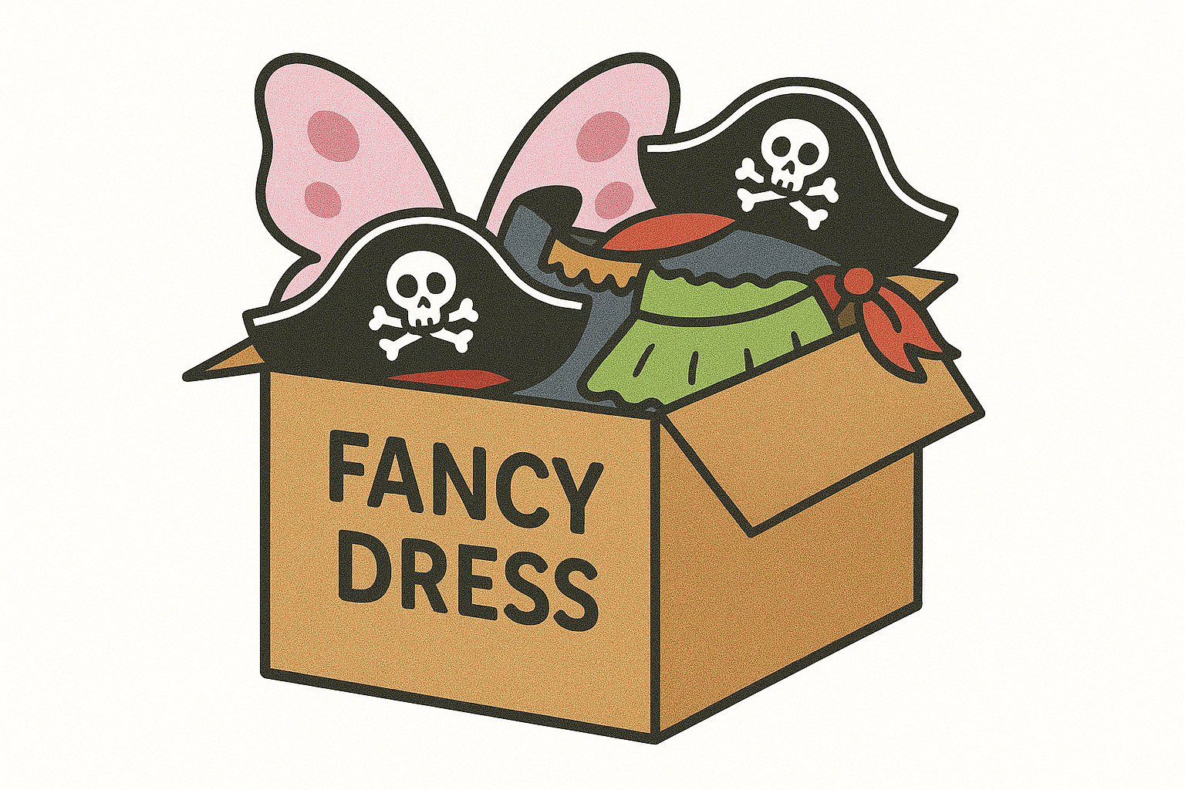
Fourth Gear: Exploring Building & Scanning
Dress Up
Family Edition
If you have more than two people playing dress up, I can scan through each person by saying “next” on my switch, they would then pass the dress up item to the person next to them.
When the item reaches the person I want to dress up I can say “you dress up!” and the person holding the item has to put it on.
 | Dress up box
 | You’ll need two talking switches for this to work. Record “Next” message onto one smooth talker switch. Record “Your dress up!” message onto the second smooth talker.
 | I’ll need both my hand switch and my head switch set up at the same time for this to work.

Slide 58
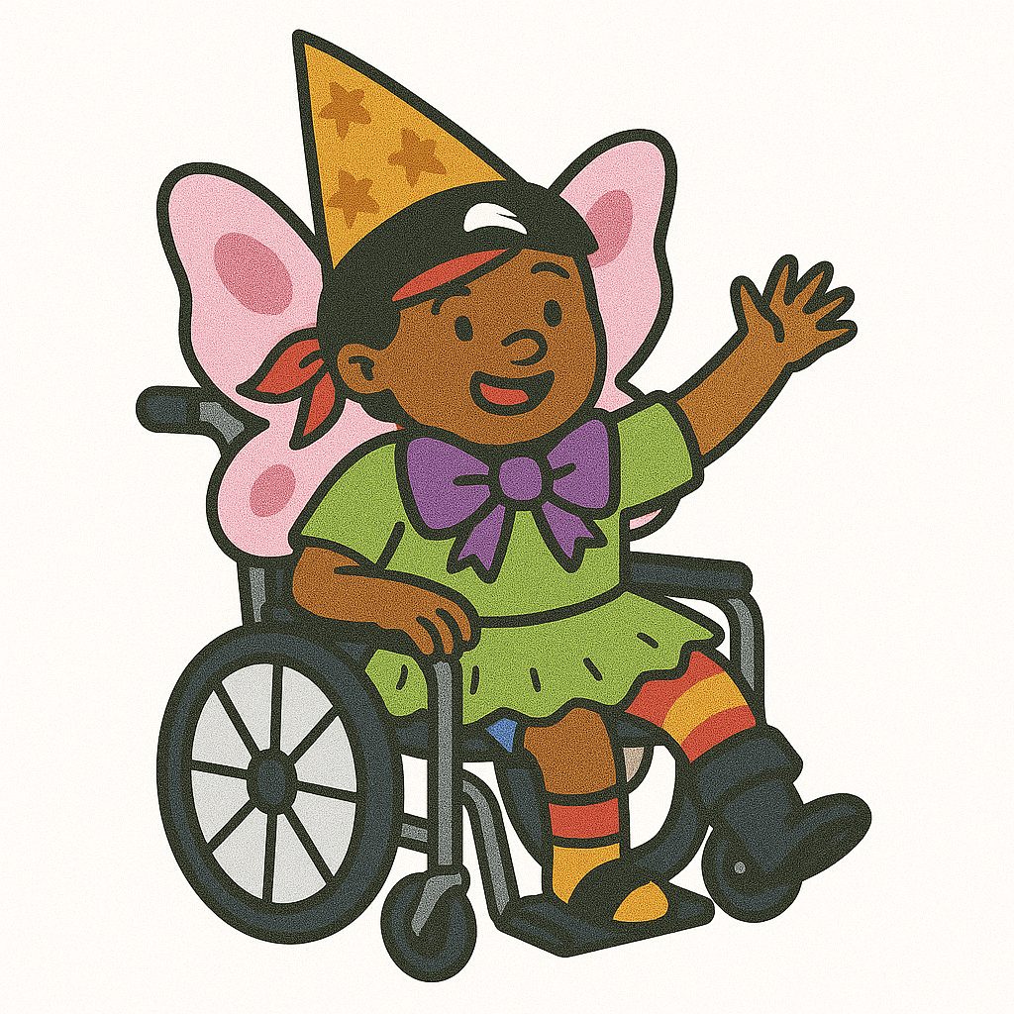
Fourth Gear: Exploring Building & Scanning
Dress Up
Just me!
Have a selection of dress up items that I can scan through and choose what I want to wear.
 | Dress up box
 | You’ll need two talking switches for this to work. Record “Next” message onto one BIGMack talking switch. Record “I want to wear this!” message onto the second BIGMack.
 | I’ll need both my hand switch and my head switch set up at the same time for this to work.

Slide 59
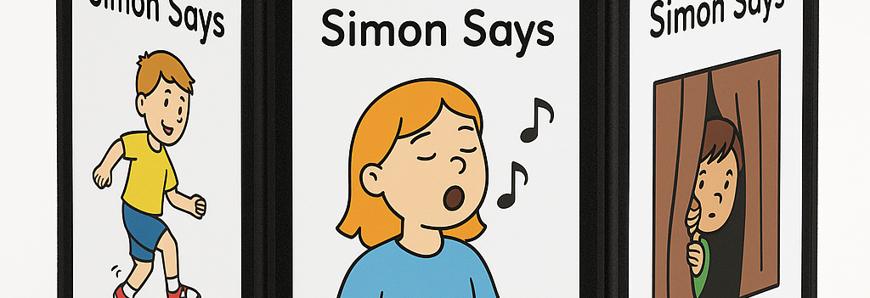
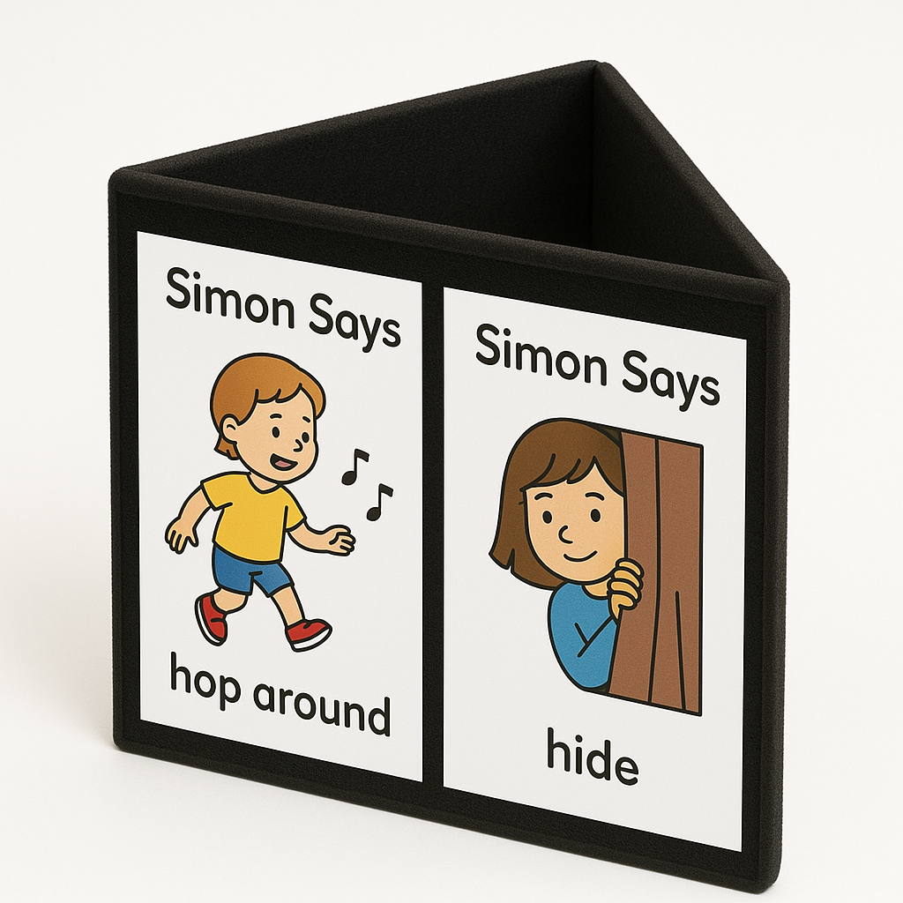
Fourth Gear: Exploring Building & Scanning
Simon Says
When I say “next” with my first switch you present the next action to me by turning the trifold to the next symbol.
When I say “Simon Says” with my second switch you must perform whatever action card you’re holding.
 | My black trifold with print-outs of the symbols for the activities
 | I’ll need both my BigMacks.
 | Record a clear “Next!” message onto one smooth talker. Record “Simon Says” onto the second smooth talker.
 | Plug my head and hand switches into the back of the smooth talker into the socket labelled “switches”

Slide 60

Fourth Gear: Exploring Building & Scanning
Humans as Animals
I use two talking switches to choose people to take turns making animal noises. The first switch scans through a group of people and the second switch tells that person to make an animal sound of their choosing.
When you hear me say “next” someone should stand so I know you’ve heard me. If I say “next” again you can sit down and then next person should stand up. If I ask you to “make an animal sound” then please do your best!
 | You’ll need two talking switches for this to work. Record “Next” message onto one BIGMack talking switch. Record “Make an animal sound” message onto the second BIGMack.
 | I’ll need both my hand switch and my head switch set up at the same time for this to work.

Slide 61
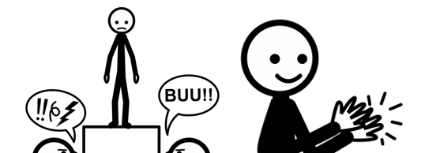
Fourth Gear: Exploring Building & Scanning
Applause and Boo
Deliver a little talent show or ask people to tell jokes. I can then choose to applaud or to shout booooo!!!
 | You’ll need two talking switches for this to work. Record “Boo!!” message onto one BIGMack talking switch. Record “Bravo!” and clapping sounds onto the second BIGMack.
 | I’ll need both my hand switch and my head switch set up at the same time for this to work.

Slide 62
Fifth Gear
Scanning with Intent

Slide 63
Fifth Gear: Scanning with Intent
Cloze Procedures in Clicker
If you type in part of the sentence, or select from the word grid, I can use my switches to scan and complete the sentence.
 | My computer running Clicker (you’ll find the icon on the desktop)
 | My cloze procedure Clicker grids (in my folder)
 | My Switch interface (JoyCable)
 | I’ll need both my hand switch and my head switch set up at the same time for this to work.

Slide 64
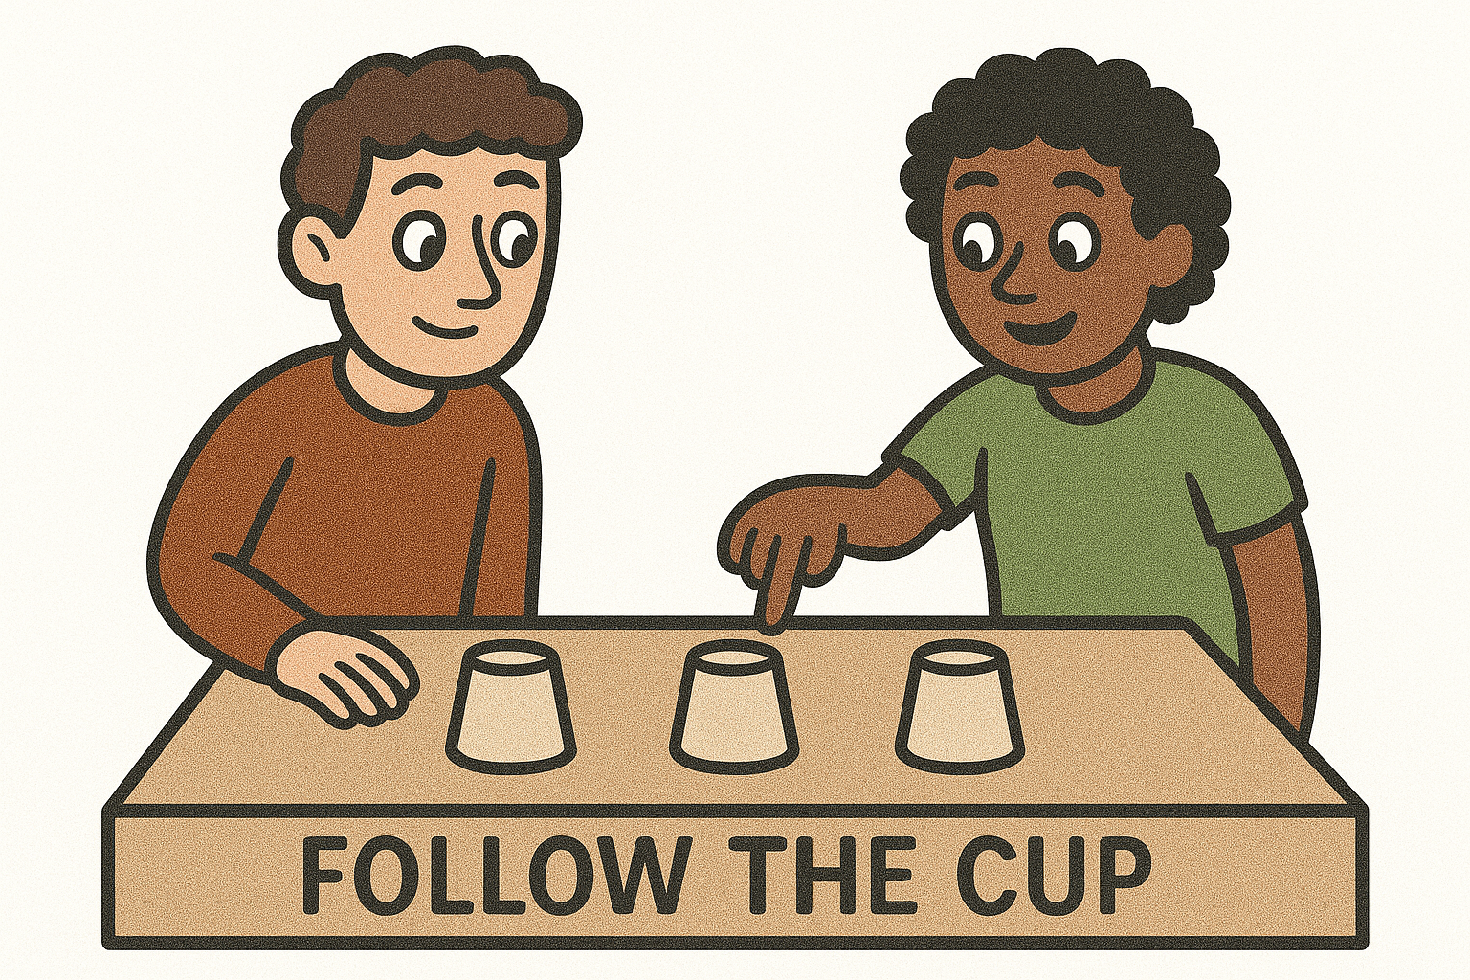

Fifth Gear: Scanning with Intent
Follow the cup
Hide a coin under one of five cups and then mix them up.
I have to guess which one I think the coin is under. Point to each cup, moving onto the next cup when I say “next” with my switch and lift the cup when I say “It’s under there!” with my other switch.
 | Five cups and a coin.
 | You’ll need two talking switches for this to work.
 | Record “Next” message onto one BIGMack talking switch. Record “It’s under here” and onto the second BIGMack.
 | I’ll need both my hand switch and my head switch set up at the same time for this to work.

Slide 65
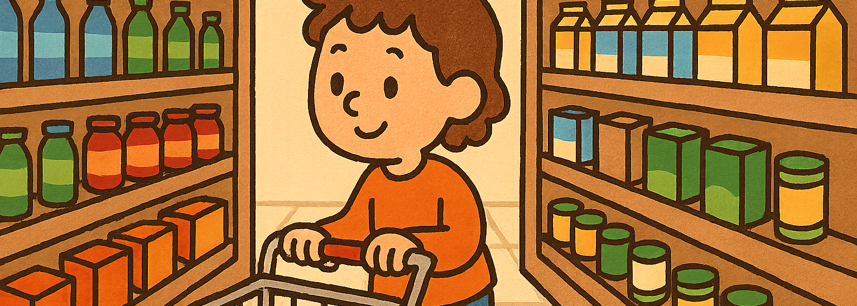
Fifth Gear: Scanning with Intent
Shopping list
Read out our shopping list (max 5 items) and have a selection of physical items for me to scan through. Some will be on our list, some wont be. Hold up each item and move onto the next when I say “next”. Put the item in our shopping cart when I say “put it in the basket!”
 | Shopping list and some items we buy from the shops.
 | You’ll need two talking switches for this to work.
 | Record “Next” message onto one smooth talker switch. Record “It’s under here” and onto the second smooth talker.
 | I’ll need both my hand switch and my head switch set up at the same time for this to work.

Slide 66

Fifth Gear: Scanning with Intent
DJ
Create the playlist for a party or event. Scan through songs and decide what makes it on the playlist and what doesn’t!
 | You’ll need two talking switches for this to work. Record “Next” message onto one BIGMack talking switch.
 | Record “This one” or “add to my set” message onto the second BIGMack.
 | YouTube is useful here to work through possible dongs, but you can also use iTunes, Spotify or any other music player.

Slide 67

Fifth Gear: Scanning with Intent
Match the Song
Test my music knowledge! Someone plays a song and gives me options of singers to choose from.
I use one switch to say “next” and the other to say “that’s the singer” when I’ve heard the right one.
 | You’ll need two talking switches for this to work. Record “Next” message onto one smooth talker switch. Record “That’s the singer” message onto the second smooth talker.

